Slide 1
M&T manage system
meeting which generate tasks

Slide 2
In my workspace
Many meetings, but no communication and no result, just reporting to boss.
Tasks without chargers and due date.
Many organizations may have similar situations

Slide 3
Meeting Report Management?
Some meeting tools like appear.in
Messenger is a good solution to communicate. KakaoTalk is s very good solution, but insufficient concentration on issue.
Two kinds of document for Business Meeting
Pre-document : issues, causes, effects, suggestions
Record : place, time, participants / talks, opinions
Report : results ~ what to do next : another meeting or tasks

Slide 4
Works flow
Meeting
Report
management
issues
analyzes
discussion
tasks
task
management

Slide 5
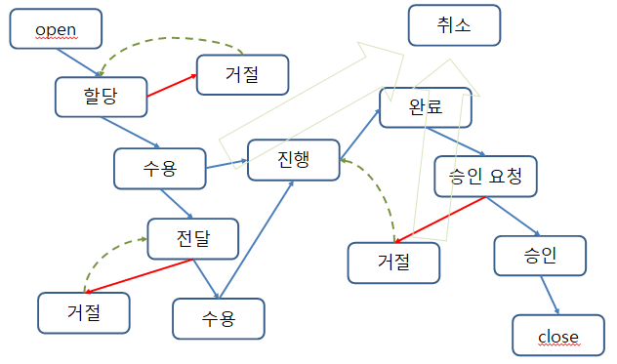
Task flow

Slide 6
Data
issue : id, title, kind, priority, contents / created(at, by)
meeting : title, kind, time, place, participants / issues, contents / created(at, by)
task : title, charger, due date, remark / created(at, by)

Slide 7
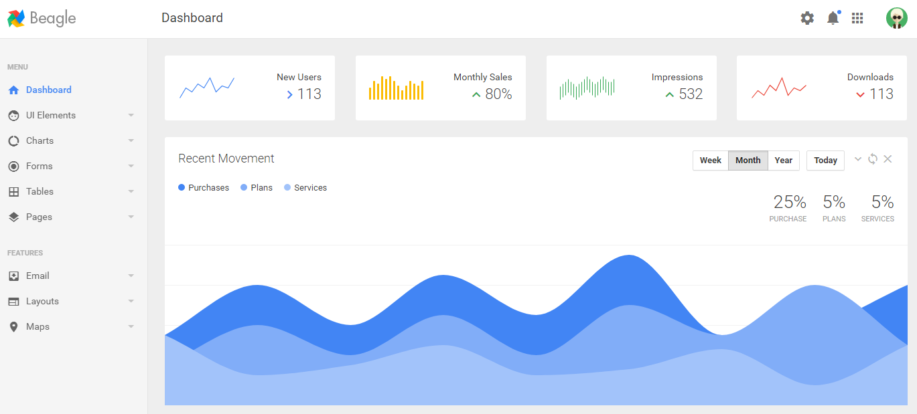
Views

Slide 8
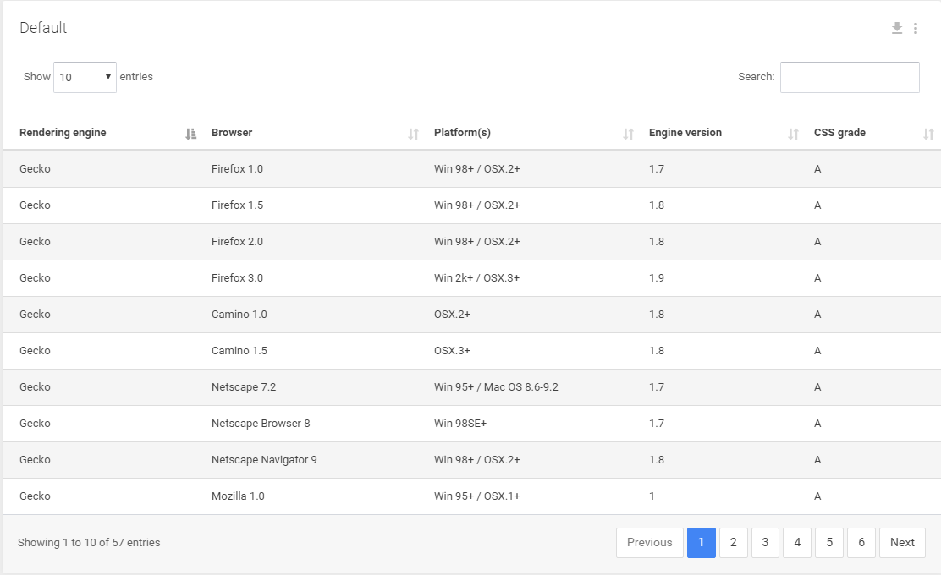
Views

